Slide 1
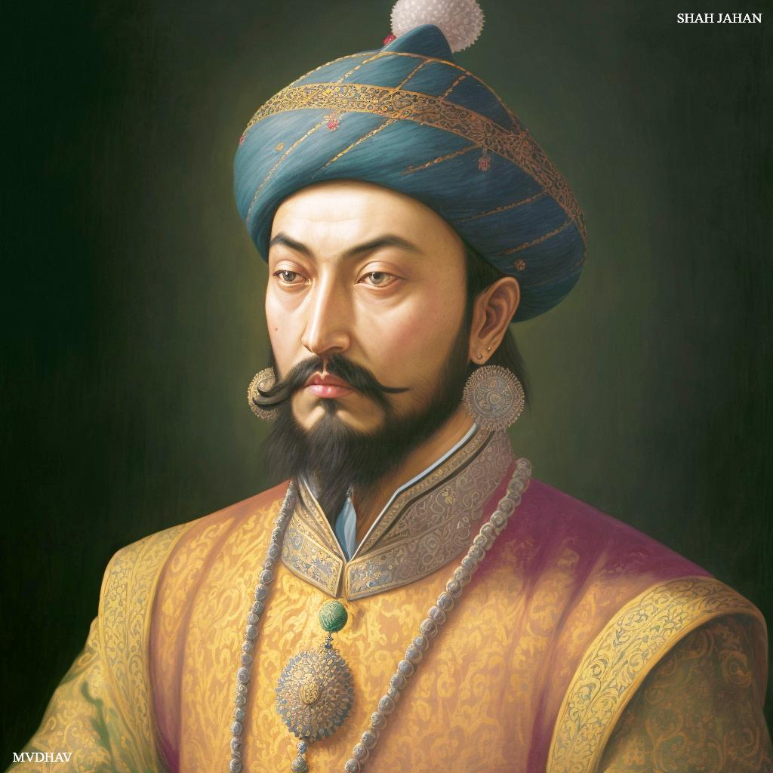
Shah Jahan
By Khubaib, Anmol, Suvan

Slide 2

Topics that we’re covering
Prince Khurram￼> Shah Jahan
Shah Jahan, the king
Military Campaigns
Architectural growth
Last years of Shah Jahan
Successors

Slide 3
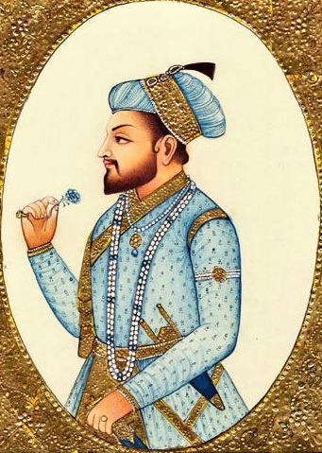
Prince Khurram >>> Shah Jahan
The first years of Shah Jahan, years in which he was known as Prince Khurram, saw the young man receive a refined and cultivated education.
He studied a large number of disciplines and became a specialist in martial arts.
He surprised his world by taking an interest in architecture.
An anecdote is told that he himself built his quarters in the Fort of Kabul, but also by proposing various internal arrangements to the fort of Agra .
By Suvan

Slide 4
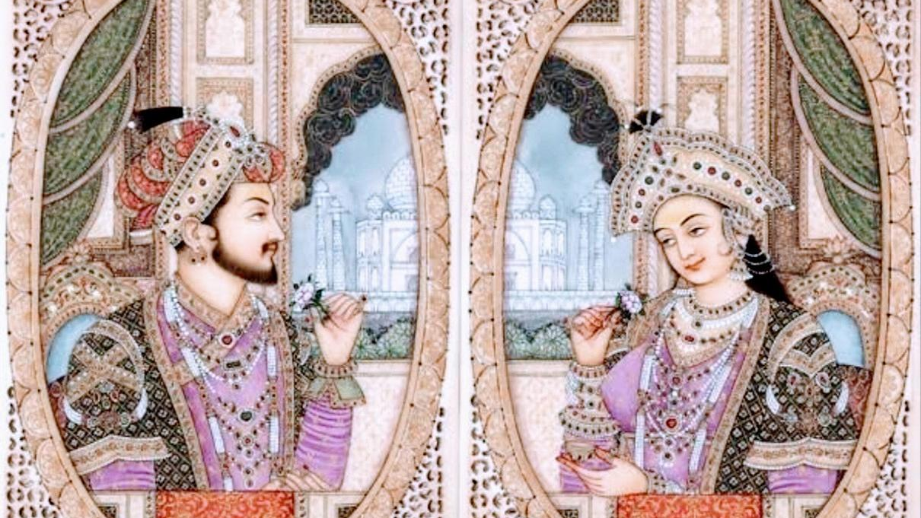
Shah Jahan, the king
Shah Jahan, whose full name was Shahab-ud-Din Muhammad Khurram, was a prominent Mughal emperor who reigned from 1628 to 1658. He is best known for his significant contributions to art and architecture, particularly for commissioning the construction of the iconic Taj Mahal.
Shah Jahan was born on January 5, 1592, in Lahore, which is now part of modern-day Pakistan.
He was the third son of Emperor Jahangir and the grandson of Emperor Akbar the Great.
His mother was Princess Manmati, and he was born into the powerful Mughal dynasty.
Shah Jahan's ascent to the throne was not without challenges. He faced fierce competition from his brothers, and after a power struggle, he emerged victorious in 1628, ascending to the Mughal throne.
He continued the policy of religious tolerance established by his predecessors, promoting the peaceful coexistence of Hindus and Muslims.
His reign witnessed a period of relative stability and prosperity, marked by notable economic, cultural, and artistic achievements.

Slide 5
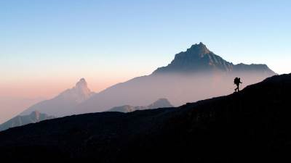
Military Campaigns
Shah Jahan crushed the rebellion of Afghan noble Khan Jahan Lodi.
Later, he defeated Bundellas and annexed Orchha.
He sent an army to Balkh and Badakhshan in Central Asia in order to add Timur’s Capital of Samarkand to his empire. This campaign, however failed.
He also failed to recover Qandahar from Safavids.
Shah Jahan invaded the Deccan and annexed Ahmednagar in 1663.
Golconda and Bijapur signed a peace treaty with him and agreed to pay an annual tribute
By Khubaib

Slide 6
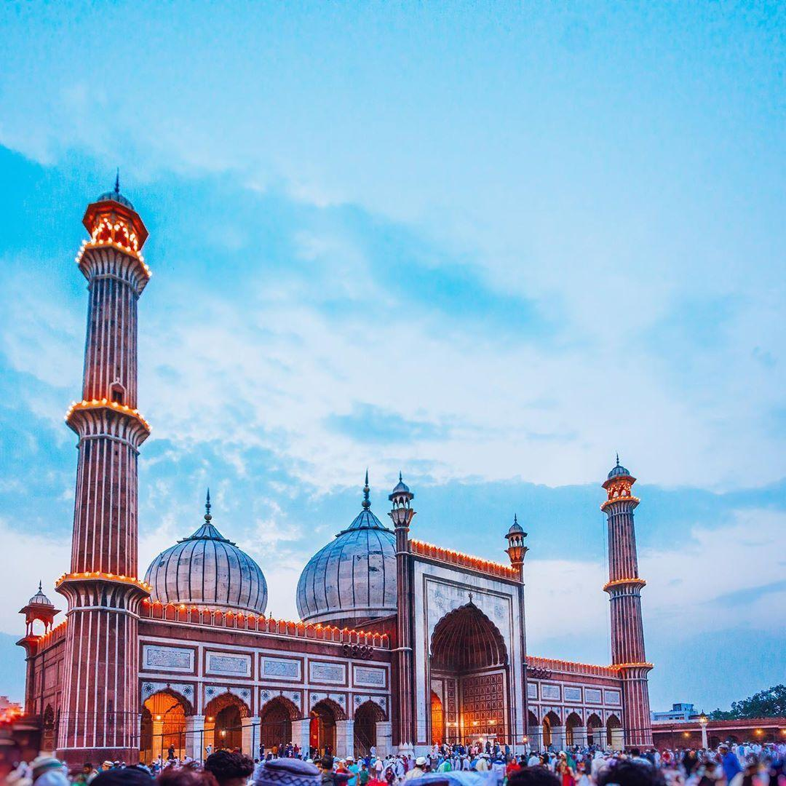
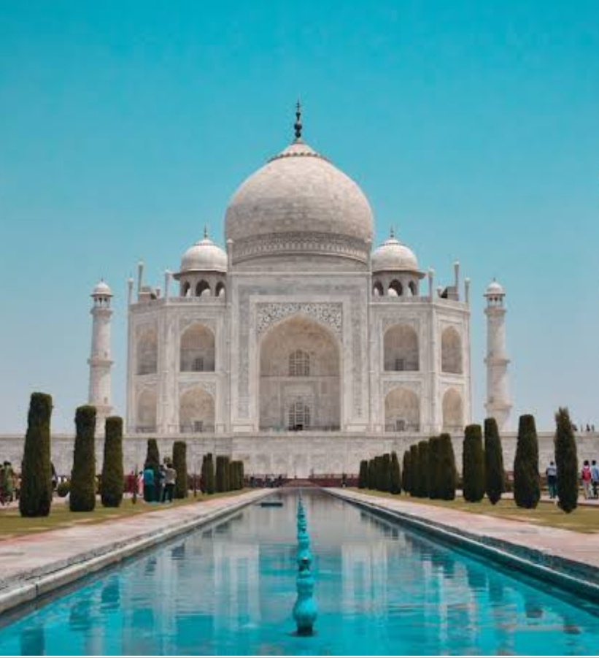
Architectural growth
Shah Jahan was renowned for his architecture and his reign has been called the Golden Age of Mughals. He is also known as the ‘Engineer King’
Under his emperorship, the Mughals reached the peak of their architectural achievements and cultural glory. Shah Jahan erected many splendid monuments, the most famous of which is the ‘Taj Mahal’ at Agra.
He built the world-famous monument -Taj Mahal at Agra in the memory of his beloved wife, Mumtaz Mahal.
He also built a new city called Shahjahanabad (the seventh city of Delhi) and made it his capital.
By Khubaib

Slide 7
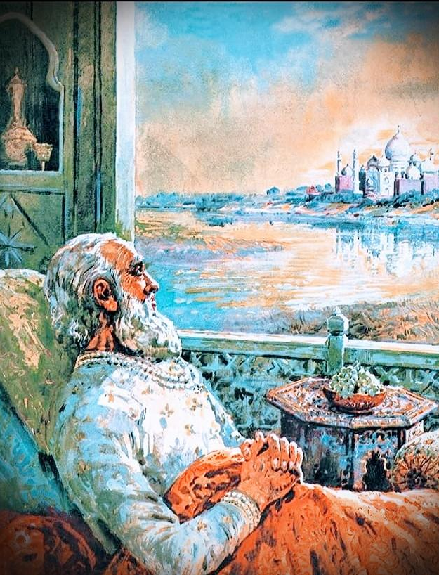
Last years of Shah Jahan
After Shah Jahan recovered from his illness in July 1658, Aurangzeb imprisoned him in the Agra Fort from July 1658 until his death in January 1666. He was laid to rest next to his daughter in the Taj Mahal.
The last days of Mughal Emperor, Shah Jahan, was spent as a prisoner in the Shah Burj of the Agra Fort for eight years. Though he was allowed all comforts in the prison and was attended by his favourite daughter Jahanara Begum, he was very closely watched and not allowed any access to the people outside.
By Anmol

Slide 8
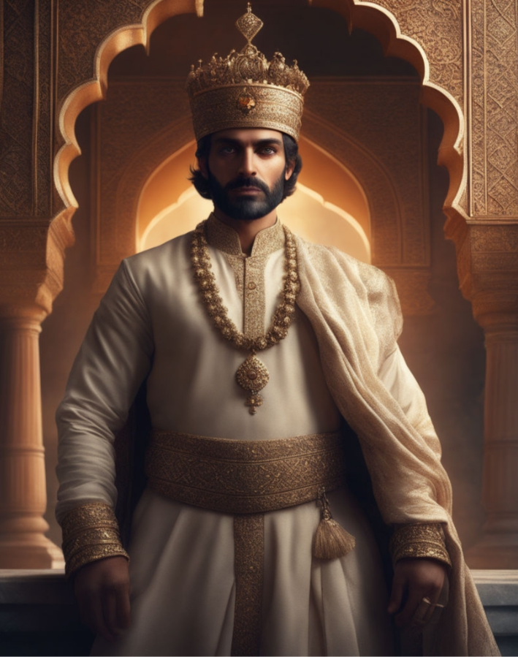
Successors
In September 1657, Shah Jahan fell ill, precipitating a struggle for succession among his four sons, Dara Shikoh, Murad Bakhsh, Shah Shuja, and Aurangzeb. The victor, Aurangzeb, defeated and killed his main rival, Dara Shikoh.
He declared himself emperor in 1658 and strictly confined Shah Jahan in Agra Fort until his death.
Aurangzeb
By Khubaib

Slide 9
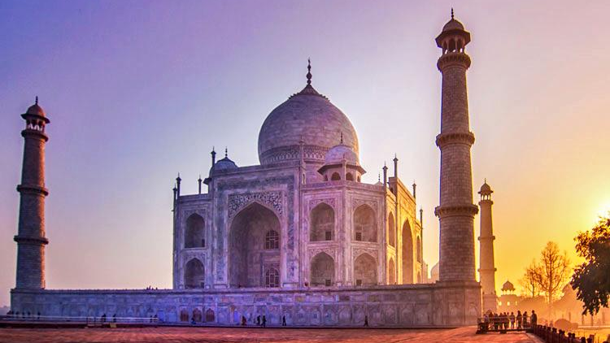
THANK YOU

